Slide 1

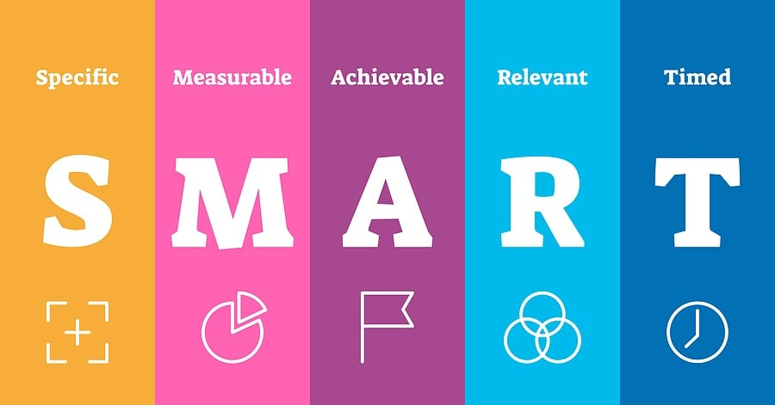
The competition
The competition
The competition
The competition
The competition
The competition
The competition
The competition

Slide 2

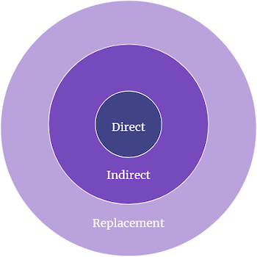
Competitive analysis
Our product
Competitive research
Our product is priced below that of other companies on the market
Simple and easy to use, compared to the complex equipment of the competitors
Company A Product is more expensive
Companies B & C Product is expensive and inconvenient to use

Slide 3
Industry overview
12%
31%
49%
91%
Retail sales
Online sales
Market sales
Product satisfaction

Slide 4
Mirjam Nilsson​ 206-555-0146 mirjam@contoso.com www.contoso.com
Thank
thank
Thank
You
You
You
you
Thank you

